Slide 1

Interactive Animations and Games
Lesson 15
Conditionals
Notes:
Lesson Plan: https://studio.code.org/s/csd3-2023/lessons/15

Slide 2
Teacher Resources
For Teachers!
Lesson Overview
This lesson introduces booleans and conditionals, which allow a program to run differently depending on whether a condition is true. Students start by playing a short game in which they respond according to whether particular conditions are met. They then move to Code Studio, where they learn how the computer evaluates Boolean expressions, and how they can be used to structure a program.
More guidance and resources for this lesson are available in the Lesson Plan:
https://studio.code.org/s/csd3-2023/lessons/15

Slide 3


Slide 4

Interactive Animations and Games Lesson 15 - Warm Up
If your last name has more than five letters, draw a square on your paper.
If your last name less than seven letters, draw a circle.
If you are wearing anything green, add 3 + 2.
If the teacher is tapping their pencil, draw an 'X'.
If the teacher is in the front of the room, fold your paper in half.

Slide 5
Interactive Animations and Games Lesson 15 - Warm Up
Journal Prompt:
When we program, we give the computer instructions of what to do.
How are these instructions different from the instructions that we have been giving in Game Lab?

Slide 6
Interactive Animations and Games Lesson 15 - Warm Up
Key Vocabulary
Condition - Something a program checks to see whether it is true before deciding to take an action.
Conditionals - Statements that only run under certain conditions.

Slide 7
Interactive Animations and Games Lesson 15 - Warm Up
Question of the Day
How can programs react to changes as they are running?

Slide 8
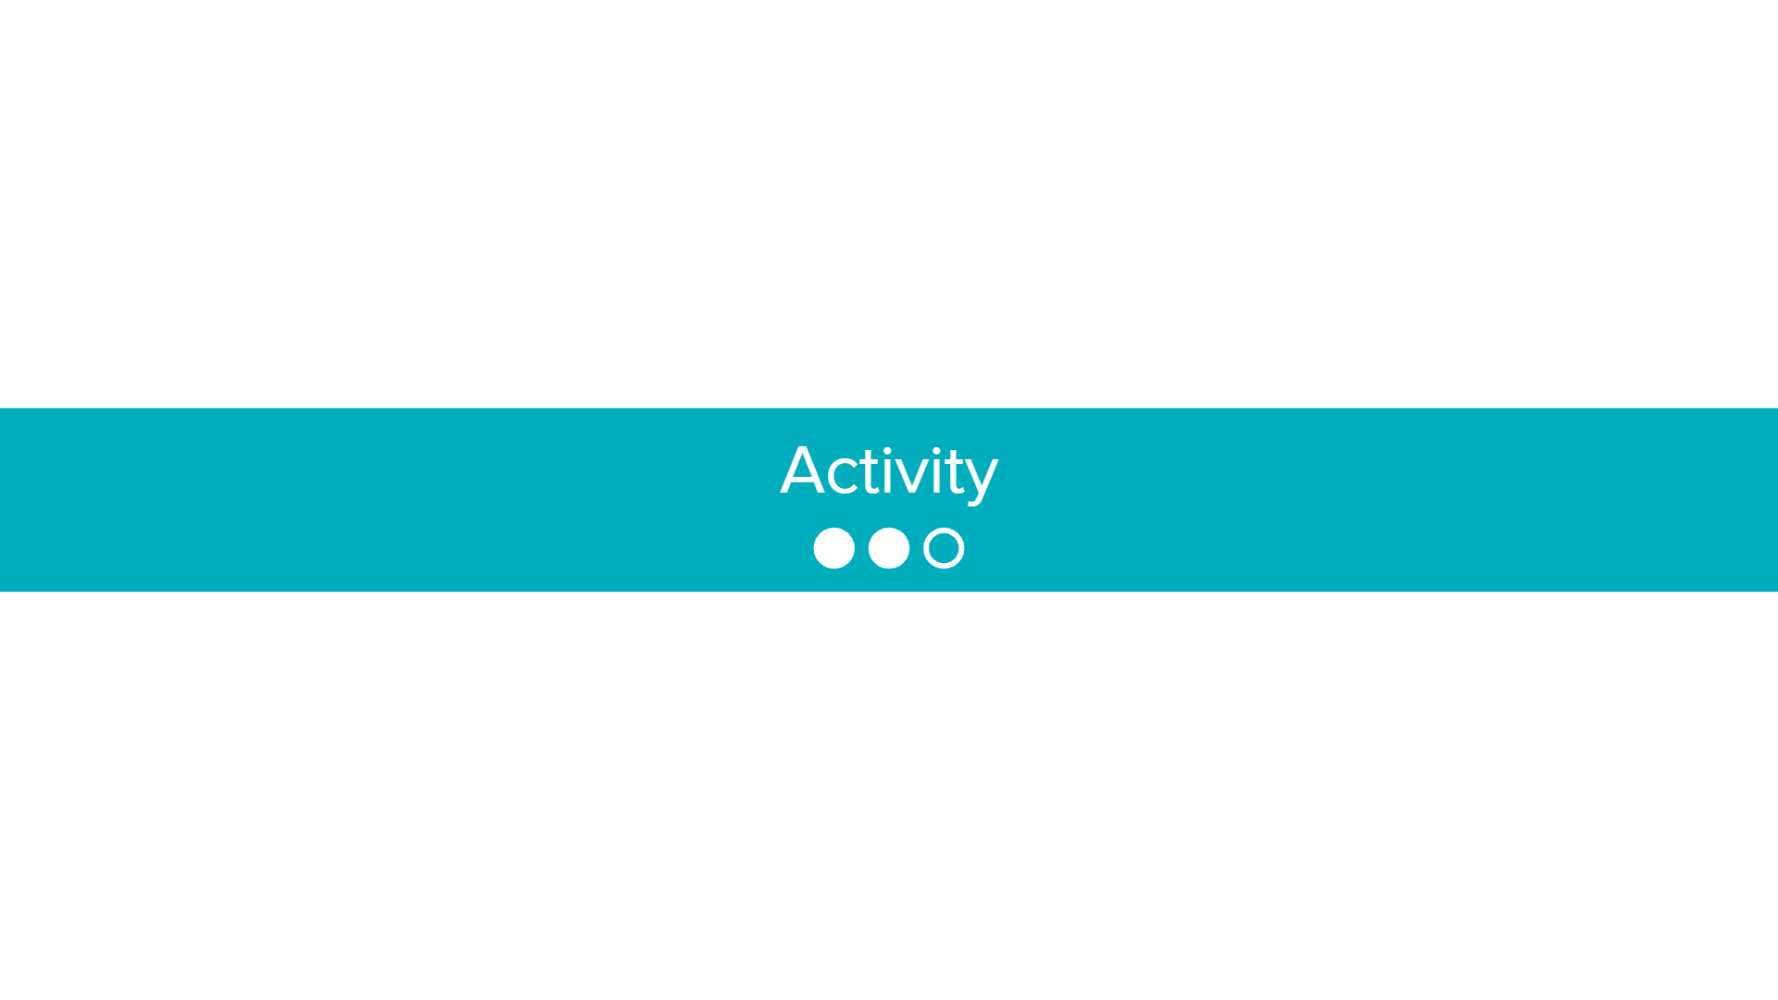

Slide 9

Interactive Animations and Games Lesson 15 - Activity
Code Studio, Level 1
Code Prediction
Read the code and discuss with your partner what you think will be printed by the program.
Run the code to test your prediction.
Discuss how the code works with your partner.

Slide 10

Interactive Animations and Games Lesson 15 - Activity
What is a Boolean expression?
What’s an expression that would evaluate to true?
What’s an expression that would evaluate to false?

Slide 11
Interactive Animations and Games Lesson 15 - Activity
Key Vocabulary
Boolean Expression - in programming, an expression that evaluates to True or False.

Slide 12
Interactive Animations and Games Lesson 15 - Activity
Code Studio, Level 2
Matching
Match the boolean expression to the English description.

Slide 13

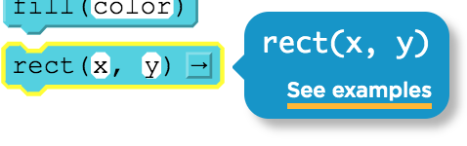

Interactive Animations and Games Lesson 15 - Activity
Code Studio, Level 3
Try it Out
Use booleans to figure out when the race car crosses the finish line.
If you get stuck, try…
Help and Tips Tab
Code Documentation
If you make a big mistake…
Use version history to go back

Slide 14
Interactive Animations and Games Lesson 15 - Activity
Code Studio, Level 4
Code Prediction
Read the code for this race car program.
What will the program do when the car reaches the finish line?
Why is the if block inside the draw loop?

Slide 15
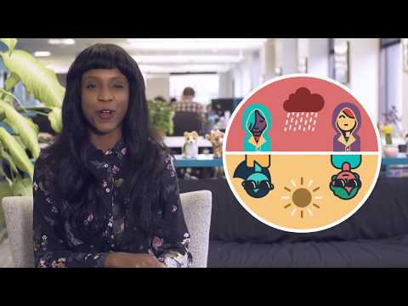
Interactive Animations and Games Lesson 15 - Activity
When would you want to use an if statement?

Slide 16
Interactive Animations and Games Lesson 15 - Activity
Code Studio, Level 5
Try it Out
Use a conditional in the draw loop to check whether fruit.scale is greater than 2. If it is, change the fruit's animation to "pear".

Slide 17
Interactive Animations and Games Lesson 15 - Activity
Code Studio, Level 6
Practice Level
Do This
Practice your new skills on these levels
Check with your teacher before moving on

Slide 18
Interactive Animations and Games Lesson 15 - Activity
Code Studio, Level 7
Assessment Level
Do This
Follow the instructions in Code Studio
The "Rubric" tab describes how to demonstrate your understanding
Check out the Help & Tips tab if you need help

Slide 19
Interactive Animations and Games Lesson 15 - Activity
Code Studio, Level 8
Challenge Level
Do This
Challenge yourself on these levels.
Learn new blocks or use the same ones in new ways.

Slide 20


Slide 21

Interactive Animations and Games Lesson 15 - Wrap Up
Journal Prompt:
Now that you know how conditionals work, where you do think that they are used in games or other programs and apps that you already use?

Slide 22
Interactive Animations and Games Lesson 15 - Wrap Up
Key Vocabulary
Condition - Something a program checks to see whether it is true before deciding to take an action.
Conditionals - Statements that only run under certain conditions.
Boolean Expression - in programming, an expression that evaluates to True or False.

Slide 23
Interactive Animations and Games Lesson 15 - Wrap Up
Question of the Day
How can programs react to changes as they are running?

